Slide 1

2021 Umpire Awards

Slide 2

Awards
The 2020 end of season survey results were used to determine what kind of awards should be provided to championship umpires
    The BOD’s believes it is important to acknowledge the accomplishment of umpiring the championships
Gr8-Call sponsored polo shirts for the semi-finals and finals umpires
Years of service pins (beginning with the 5th year pin and continuing in 5 year increments) were created starting with 2021 and 2022 seasons
    Umpires will receive a pin for their anniversary at the next milestone
All awards will presented at the “Welcome Back” Kickoff Area meetings

Slide 3
Years of Service
25+ Years in 2021 or 2022
25 Years | Area
Kevin Ainsworth | Denver
Terry Angell | Denver
John-David Broderius | Greeley
Terry Crow | Colorado Springs
Wade Dean | Denver
John Gonzales Jr | Trinidad
Sean Grogan | Fort Collins
John Juranek Jr | Denver
Calvin Martin | Pueblo
Robert Prokopec | Colorado Springs
Jeffrey Remley | Colorado Springs
Gerald Santos | Pueblo
Dale Velchkoff | Denver
Bill Woodson | Denver
30 Years | Area
Steven Alexander | Grand Junction
David Bogen | Denver
35 Years | Area
Roger Pratt | Colorado Springs
Larry Lawhead | Greeley
Richard Plankis | Delta/Montrose
David Schroeder | Delta/Montrose
40 Years | Area
Hal Kappius | Greeley
Richard Peecher | Lamar
45 Years | Area
Dan Weikle | Boulder
50 Years | Area
Steven Heuer | Denver

Slide 4
2021 Semi-Finals Umpires
Kevin Ainsworth | Chuck French | Scott Lindenberg
David Anson | Richard Gillenwaters | Chris Lundwall
Everett Bates | Allan Hampson | David Martinez
Bill Beasley | Terry Haynie | Terry Reed
Pat Corcoran | Steve Heuer | Damian Savolt
George Demetriou | Greg Holstine | Steve Schleper
Jason Dittburner | Don Howard | Vern Scott
Brandon Driessen | Larry Lawhead | Bryan Sperry
Bill Fleming | Reid Lester | Gary Weibert

Slide 5
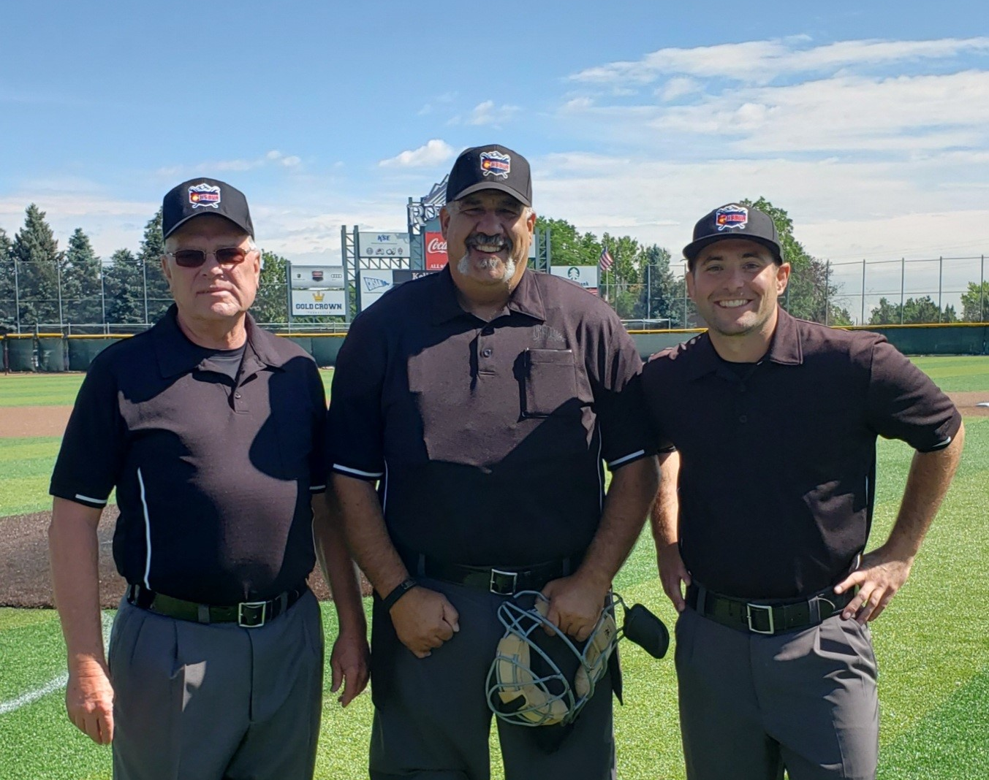
5A Championship Umpires
Brian Wheeler
Grand Junction
Tom Albano
Denver
Jordan Bishop
Loveland

Slide 6
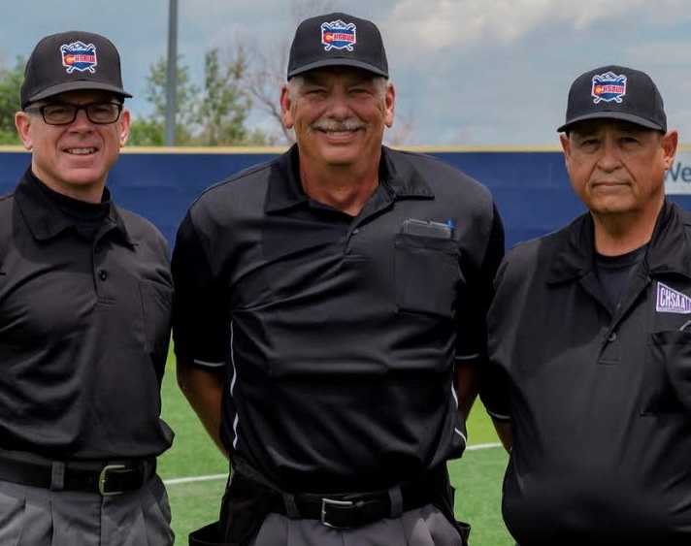
4A Championship Umpires
Jim Knapp
Denver
Mark Boger
Colorado Springs
Pat Garcia
Pueblo

Slide 7
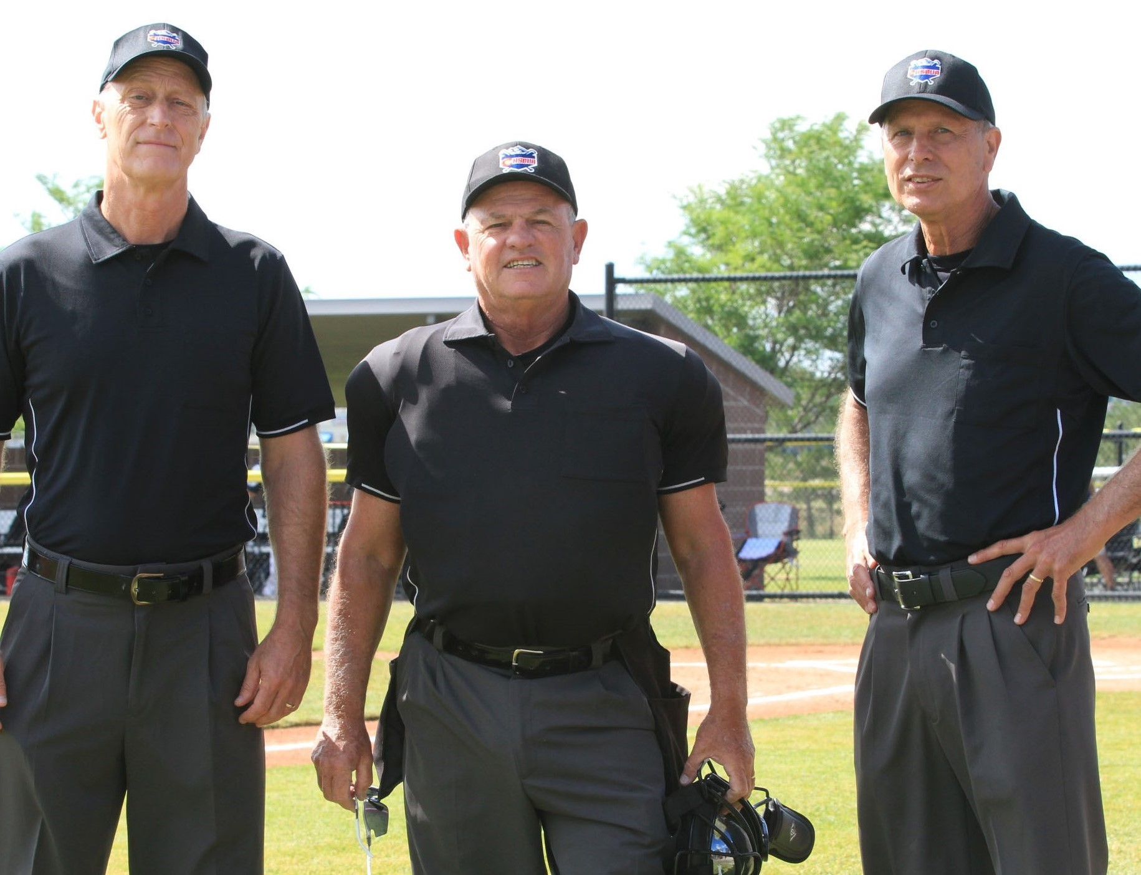
3A Championship Umpires
Neil Holstein
Fort Collins
Mike Coulter
Denver
Tony Fourcroy
Fort Collins

Slide 8
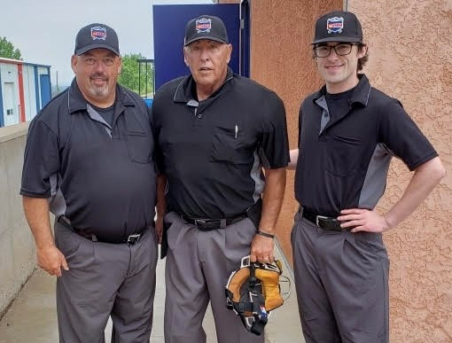
2A Championship Umpires
Bob Richardson
Glenwood Springs
Rick Soares
Pueblo
Peter Hinamen
Denver

Slide 9
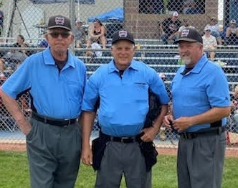
1A Championship Umpires
Fred Zuercher
Colorado Springs
Norm Johnson
Greeley
Ron Metcalfe
Yuma

