Slide 1
John Sullivan – CHSAA Asst Commissioner
GEORGE DEMETRIOU – RULES INTERPRETER george.Demetriou.cos@GMAIL.COM
2024 NFHS Baseball Rule changes
Powerpoint

Slide 2
SUMMARY
Wristbands
One-way Communication
Spectators

Slide 3
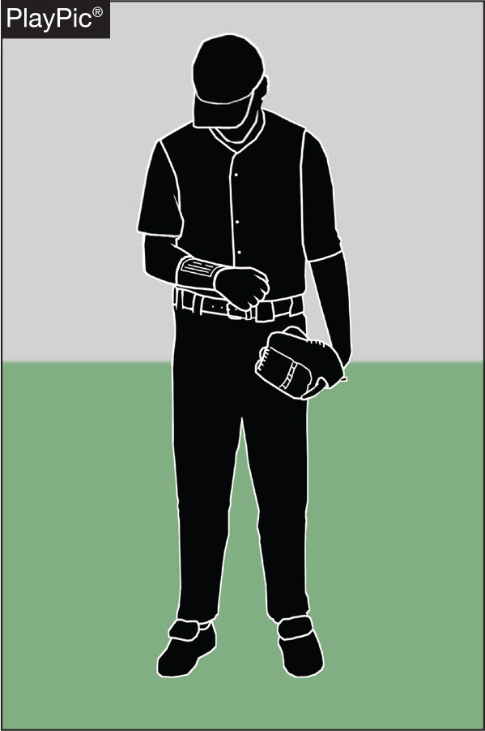
1-6-1
PLAYER COMMUNICATION EQUIPMENT
• Any wristband with defensive shifts/offensive plays/pitching choices or game directions attached is non-electronic equipment and is permitted as long as it a single, solid color.

Slide 4
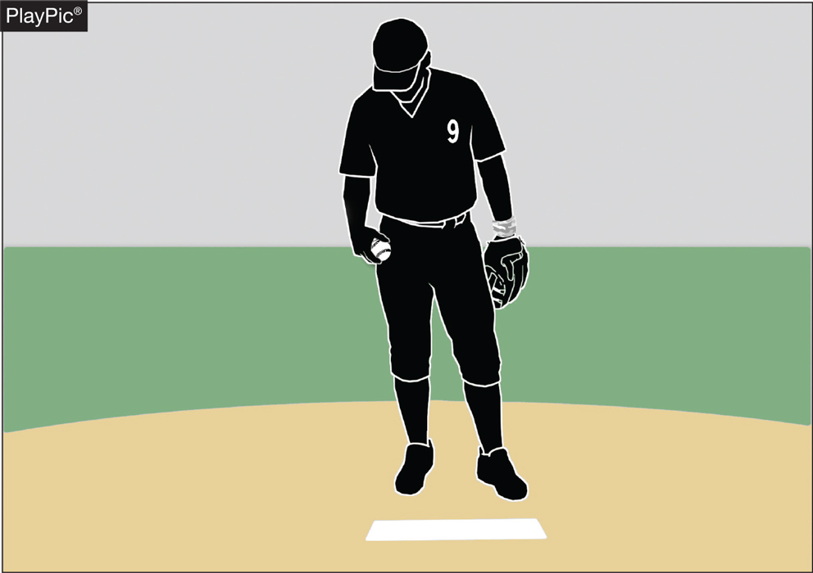
1-6-1
PLAYER COMMUNICATION EQUIPMENT
• For pitchers, it may not contain the colors white, gray or be distracting.
• It does not have to match the color of the uniform or the sleeves worn underneath the uniform.
• It shall only be worn on player(s) wrist or forearm and pitchers shall wear it on their non-pitching arm.

Slide 5
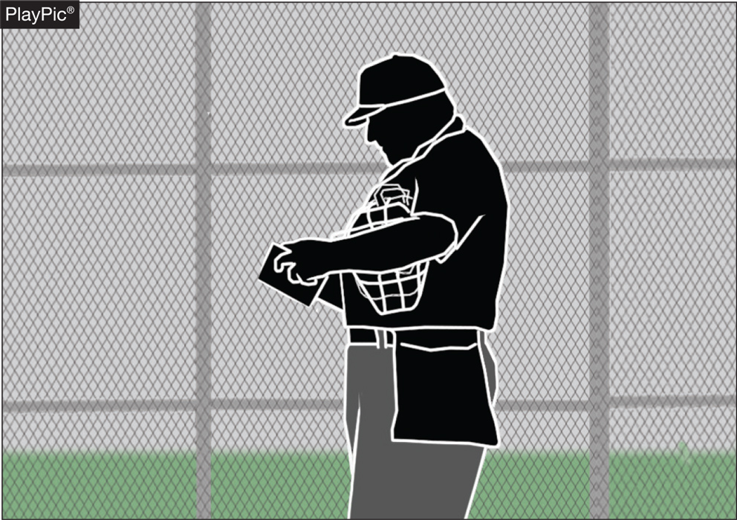
1-6-1
PLAYER COMMUNICATION EQUIPMENT
• The penalty for wearing this equipment improperly is a team warning to the coach on a first offense.
• The next offender of that team will be ejected along with the team’s head coach.

Slide 6
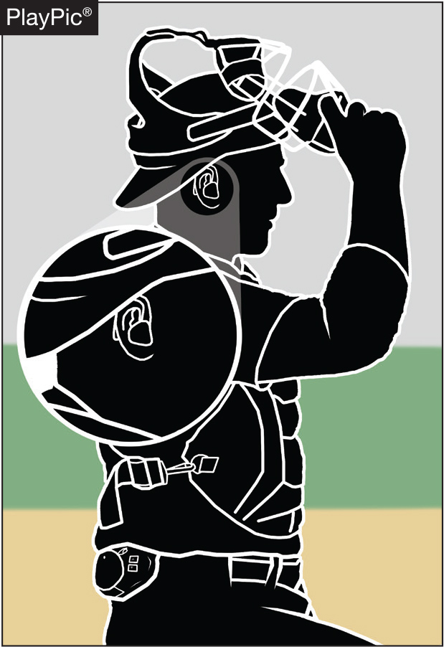
PLAYER COMMUNICATION EQUIPMENT rule 3-2-5
• One-way electronic communication devices are permissible from the dugout to the catcher while the team is on defense for the purpose of calling pitches.

Slide 7
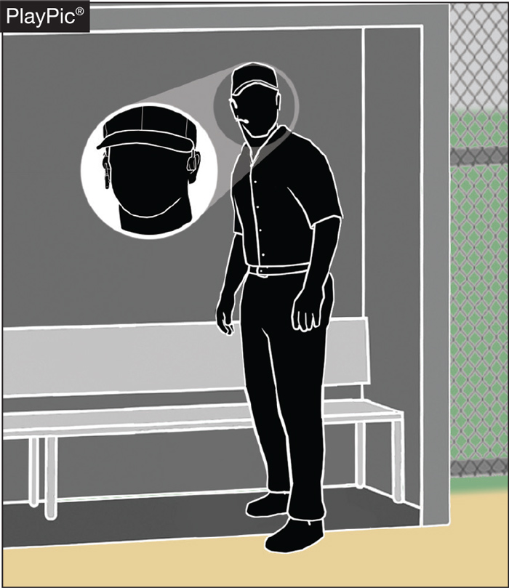
PLAYER COMMUNICATION EQUIPMENT rule 1-6-2
• When using the electronic communication device, the coach cannot be outside the dugout/bench area.

Slide 8
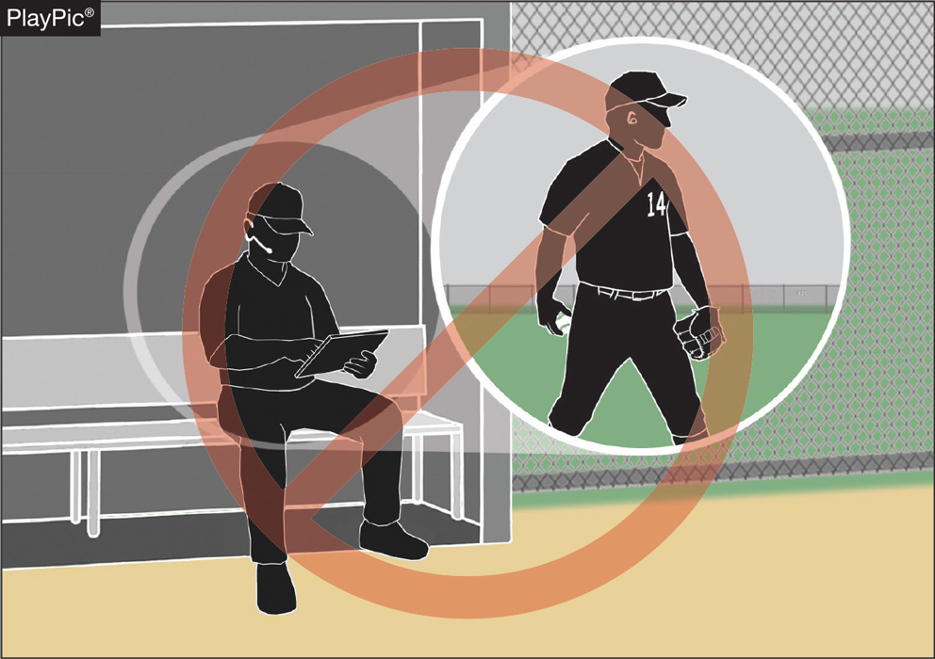
PLAYER COMMUNICATION EQUIPMENT rule 3-2-5
• Coaches may not use electronic communication device(s) to communicate with any other team member than the catcher while on defense, or any team member while on offense.

Slide 9
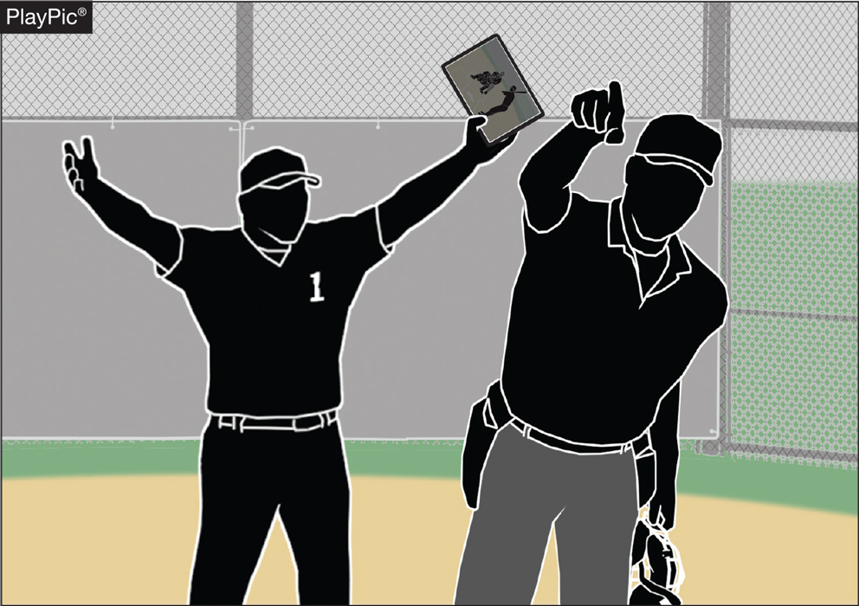
PLAYER COMMUNICATION EQUIPMENT rule 3-2-5
• The penalty for improper use is a team warning on the first offense.
• The next offender of that team will be ejected, along with the team’s head coach.

Slide 10
UMPIRE-IN-CHIEF rule 10-2-3h
h. Forfeit the game for prescribed infractions by spectators, coaches, players or team/bench personnel.
Rationale:
Umpires have jurisdiction over the confines of the field, players, coaches and team/bench personnel. If there are issues with spectators, it is the responsibility of game management to deal with spectators and to ensure that the facility is safe for all involved.

Slide 11
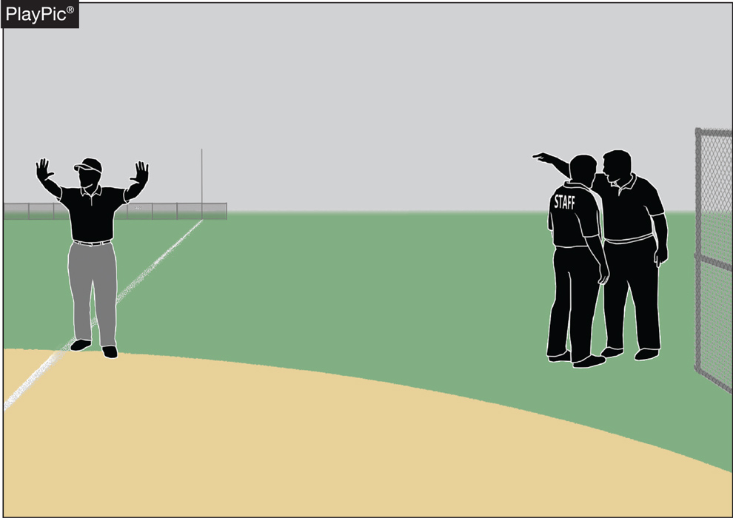
UMPIRE-IN-CHIEF
Rule 10-2-3h
• Umpires have jurisdiction over the confines of the players, coaches and team/bench personnel.
• If there are issues with spectators, it is the responsibility of game management to deal with spectators and to ensure the facility is safe for all involved.

Slide 12
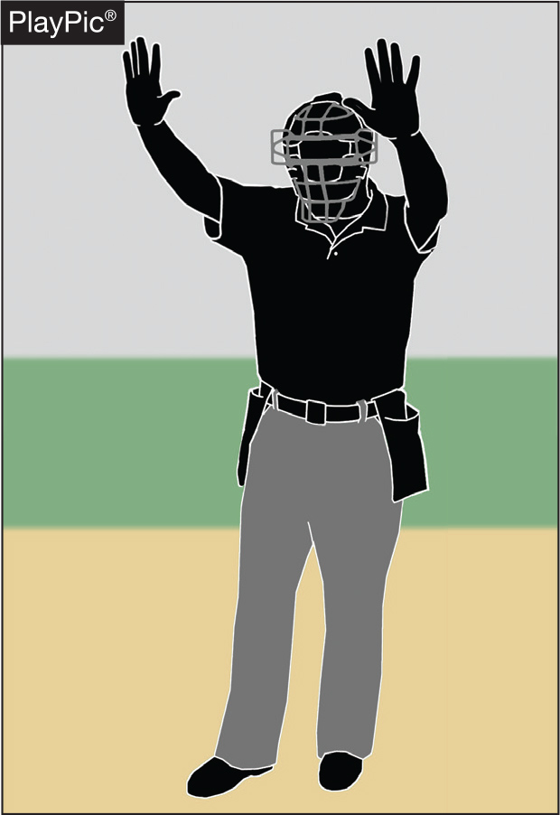
UMPIRE-IN-CHIEF
Rule 10-2-3h
• The umpire-in-chief may forfeit the game for prescribed infractions by coaches, players or team/bench personnel.
Most likely repeated refusal to comply
See Rule 4-4.
Do not declare a forfeit if a team is late arriving.
  Please wait 30 min if no info.
  Note in the game report.

Slide 13
2024 NFHS BASEBALL
Points of Emphasis

Slide 14
Approaching Umpires
State Association Adoption
Head coaches can ask an umpire to get help on a:
Rules clarification;
Pulled foot or swipe tag; or
Dropped ball.

Slide 15
Approaching Umpires
State Association Adoption
Coaches may ask an umpire what he saw on:
Balks;
Obstruction;
Interference; or
Any other unusual play.

Slide 16
Approaching Umpires
State Association Adoption
Coaches must avoid questioning:
Balls and Strikes including checked swings; and
Outs and safes especially bang-bang plays.

Slide 17
EJECTION PROTOCOL
State Association Adoption
    PRINCIPLES
    Assistant Coaches cannot argue calls with umpires.
    Be as tolerant and understanding as possible with Head Coaches
    PROCEDURE
  Ignore comments as long as possible
  Acknowledge as appropriate; answer relevant questions
  Warn before lines are crossed or chattering is incessant
  Restrict
  Eject

Slide 18
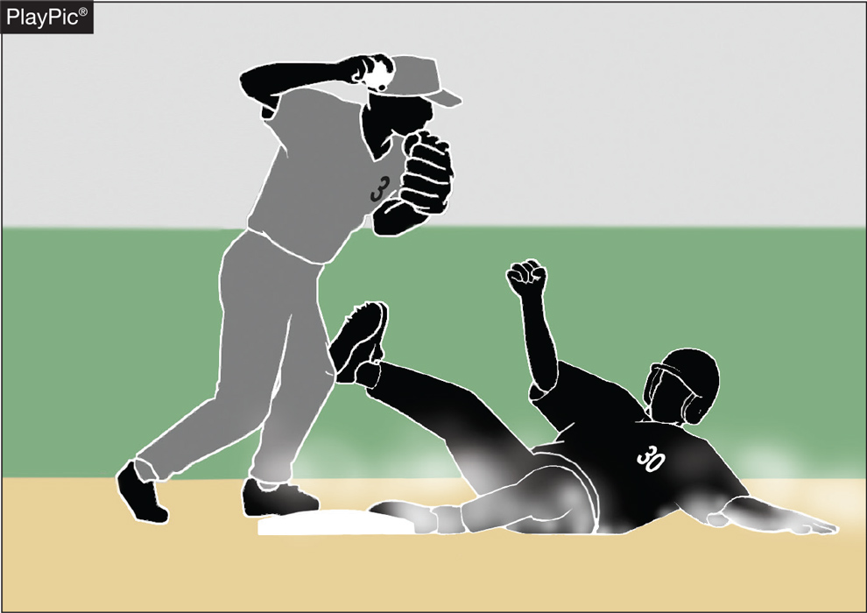
Malicious contact
Malicious contact can be initiated by either an offensive or defensive player(s).
It should not be confused with incidental contact or “train wreck” plays that sometimes occur in baseball.
Notes:
NFHS playing rules are written to encourage sportsmanship. Participation in these programs should promote respect, integrity and sportsmanship. However, for these ideals to occur, everyone involved in these programs must be doing their part.
Sportsmanship, or good sporting behavior, is about treating one another with respect and exhibiting appropriate behavior. It is about being fair, honest and caring. When these types of appropriate behavior occur, competitive play is more enjoyable for everyone.

Slide 19
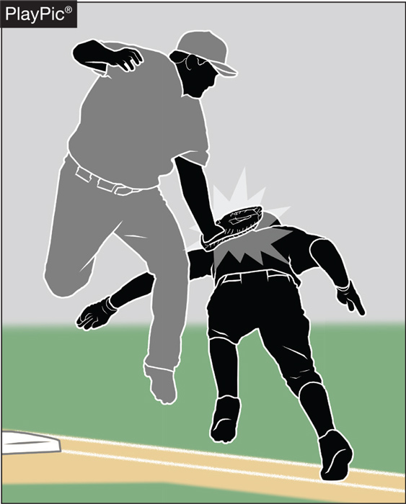
Malicious contact
Contact or a collision is considered to be malicious if it the result of excessive force and/or there is an intent to injure.
The absence of these two conditions does not preclude the presence of malicious contact but would provide a reasonable starting point for proper interpretation.
Notes:
NFHS playing rules are written to encourage sportsmanship. Participation in these programs should promote respect, integrity and sportsmanship. However, for these ideals to occur, everyone involved in these programs must be doing their part.
Sportsmanship, or good sporting behavior, is about treating one another with respect and exhibiting appropriate behavior. It is about being fair, honest and caring. When these types of appropriate behavior occur, competitive play is more enjoyable for everyone.

Slide 20
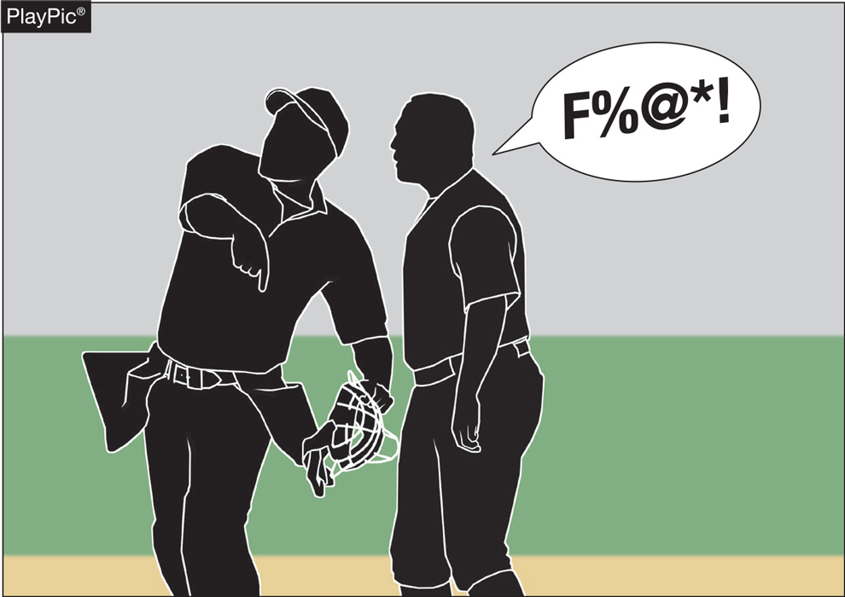
Profanity (DIRECT OR INDIRECT)
Education-based athletics is a direct extension of the classroom.
The coach is the teacher.
There is no excuse for “foul language” in school or on the baseball field.
What is “foul” is an opinion.
Consider context, target, tone and any gestures
Notes:
NFHS playing rules are written to encourage sportsmanship. Participation in these programs should promote respect, integrity and sportsmanship. However, for these ideals to occur, everyone involved in these programs must be doing their part.
Sportsmanship, or good sporting behavior, is about treating one another with respect and exhibiting appropriate behavior. It is about being fair, honest and caring. When these types of appropriate behavior occur, competitive play is more enjoyable for everyone.

Slide 21
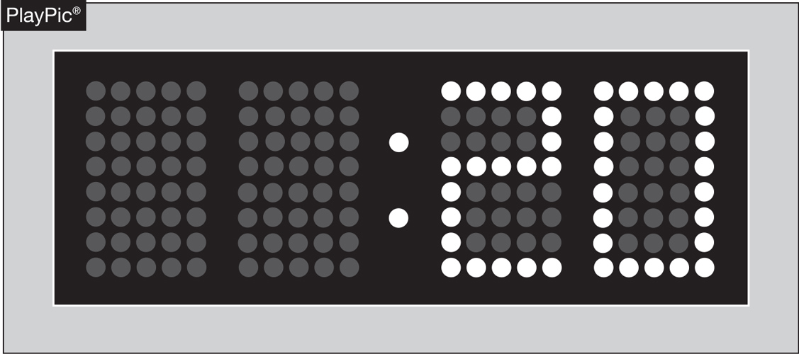
PACE OF PLAY
A 20-second time limit rule has been in the NFHS rules book since the 1970s.
The rule is meant to only be utilized when other preventive umpiring measures fail to achieve a reasonable pace or rhythm.
Notes:
NFHS playing rules are written to encourage sportsmanship. Participation in these programs should promote respect, integrity and sportsmanship. However, for these ideals to occur, everyone involved in these programs must be doing their part.
Sportsmanship, or good sporting behavior, is about treating one another with respect and exhibiting appropriate behavior. It is about being fair, honest and caring. When these types of appropriate behavior occur, competitive play is more enjoyable for everyone.

Slide 22
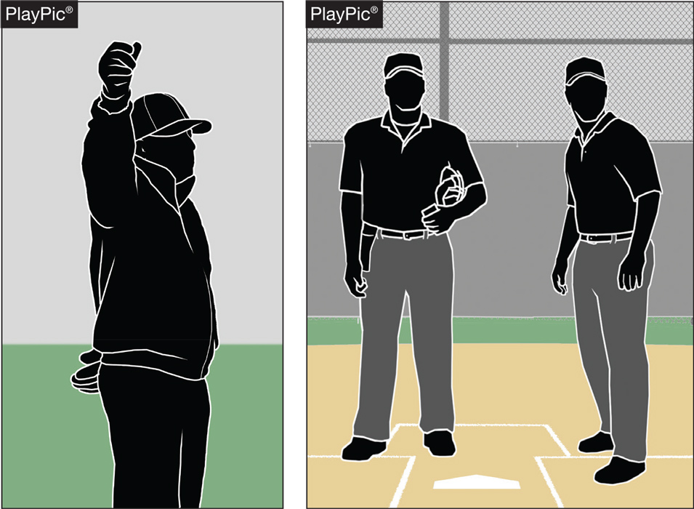
PACE OF PLAY
By rule, the time between the last out of one half-inning and the first pitch of the next half-inning is 1 minute, 20 seconds.
Umpires should facilitate this and refrain from visiting with fans or having prolonged discussions with other crew members.
Notes:
NFHS playing rules are written to encourage sportsmanship. Participation in these programs should promote respect, integrity and sportsmanship. However, for these ideals to occur, everyone involved in these programs must be doing their part.
Sportsmanship, or good sporting behavior, is about treating one another with respect and exhibiting appropriate behavior. It is about being fair, honest and caring. When these types of appropriate behavior occur, competitive play is more enjoyable for everyone.

Slide 23
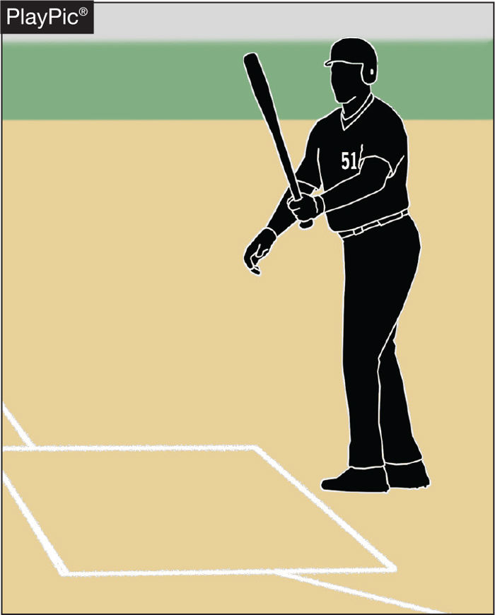
PACE OF PLAY
Rule 7-3-1 spells out the situations when a batter is allowed to leave the batter’s box.
Repeatedly stepping out to alter the rhythm of the pitcher or delay the game is not acceptable, and umpire needs to apply the proper penalty.
Notes:
NFHS playing rules are written to encourage sportsmanship. Participation in these programs should promote respect, integrity and sportsmanship. However, for these ideals to occur, everyone involved in these programs must be doing their part.
Sportsmanship, or good sporting behavior, is about treating one another with respect and exhibiting appropriate behavior. It is about being fair, honest and caring. When these types of appropriate behavior occur, competitive play is more enjoyable for everyone.

Slide 24
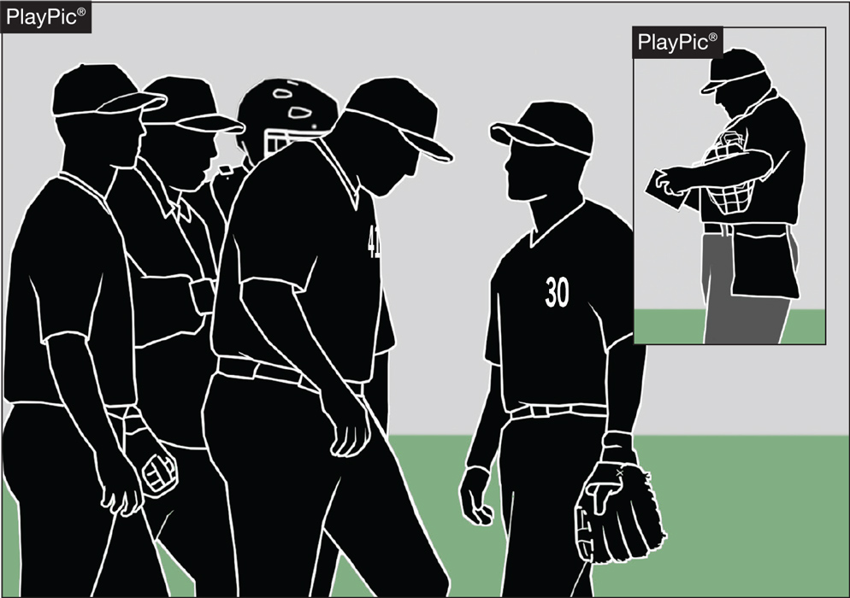
PACE OF PLAY
Umpires need to be consistent in monitoring how teams get on/off the field, conferences, enforcing the batter’s box rule and in other areas to create a sense of urgency during the contest.
Notes:
NFHS playing rules are written to encourage sportsmanship. Participation in these programs should promote respect, integrity and sportsmanship. However, for these ideals to occur, everyone involved in these programs must be doing their part.
Sportsmanship, or good sporting behavior, is about treating one another with respect and exhibiting appropriate behavior. It is about being fair, honest and caring. When these types of appropriate behavior occur, competitive play is more enjoyable for everyone.

Slide 25
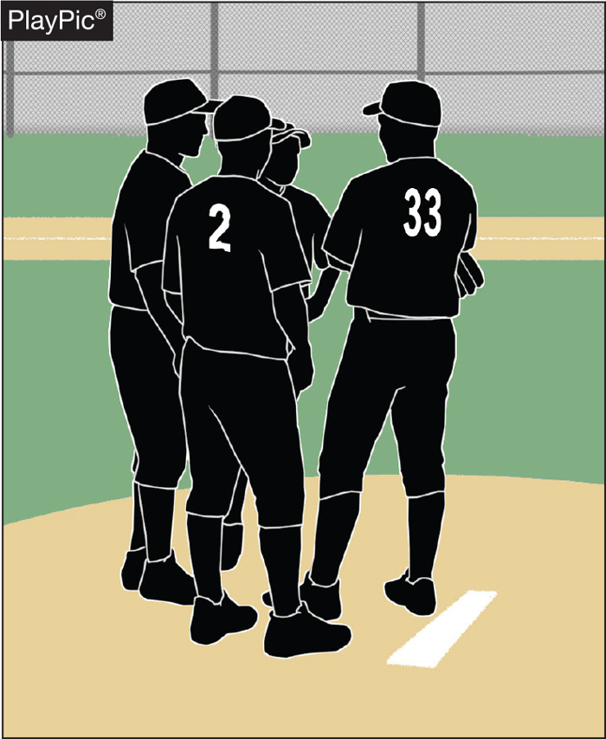
PACE OF PLAY
Umpires need to recognize when excessive player conferences begin to delay the game, step in and expedite the conclusion of the meeting.
Notes:
NFHS playing rules are written to encourage sportsmanship. Participation in these programs should promote respect, integrity and sportsmanship. However, for these ideals to occur, everyone involved in these programs must be doing their part.
Sportsmanship, or good sporting behavior, is about treating one another with respect and exhibiting appropriate behavior. It is about being fair, honest and caring. When these types of appropriate behavior occur, competitive play is more enjoyable for everyone.

Slide 26
SPEED-UP RULES
State Association Adoption
Courtesy runners for the pitcher and catcher may be used to include the player/DH, if used.
Teams may huddle outside the dugout before coming to bat, but may not huddle before taking the field.
After the pitcher completes his warm-ups, players may not huddle at the mound.

Slide 27
MERCY RULES
State Association Adoption
The game ends when:
The visiting team is behind 20 or more runs after 2 ½ innings, or if either team is ahead by 20 or more runs after the third inning;
The visiting team is behind 15 or more runs after 3 ½ innings, or if either team is ahead by 15 after the fourth inning;
The visiting team is behind 10 or more runs after 4 ½ innings, or after the fifth inning, if either team is ahead by 10 runs in an equal number of innings.

Slide 28
GAME ENDING PROCEDURES
State Association Adoption
Regular Season Games: In the following three situations, any game which is terminated by darkness, rain or other cause will be considered a suspended game and shall continue from that point of suspension at the earliest time possible:
Before it is a regulation game, or
After it is a regulation game, and
  It is tied, or
  An inning is in progress and before the inning is completed, the visiting team has scored one or more runs to take the lead, and the home team has not retaken the lead.

Slide 29
GAME ENDING PROCEDURES
State Association Adoption
Post Season Games:
All games will be played to their conclusion in seven innings unless the mercy rule comes into effect or extra innings are needed.
All suspended games at the district, regional and state level shall be completed from the point of suspension to the conclusion of the contest at the earliest time possible.
NOTE: In all cases, the pitches thrown count toward the maximum number of pitches allowed.

Slide 30
GAME ENDING PROCEDURES
State Association Adoption
Sub Varsity Games:
Sub varsity games have a two-hour time limit. A new inning will not begin after the limit is reached. The home team is entitled to bat in the limited inning even if they are ahead. The limit begins when the lineups are exchanged at the pre-game conference. This adoption does not affect coaches mutually agreeing to end a game at any point.
Varsity Tournament Games:
If time limits are part of the tournament structure, all schools, athletic directors and coaches who participate have given tacit approval for the stated time limit. Any subsequent change to the time limit must be approved by both coaches.

Slide 31
MEDIA AREAS
State Association Adoption
Formal media areas will not be established.
Media personnel are anyone with a camera or any member of the media who the plate umpire approves to be on the field.
For playoff games, only credentialed media will be allowed on the field.
For regular season games, it is the plate umpire’s discretion to determine who to allow on the field. Such personnel must be mobile and must stay against the fence. For non-compliance, they may be asked to leave.
  Anyone who intentionally interferes shall be removed from the confines of field and reported to CHSAA via the game report. Subsequent violators shall be banned from CHSAA events for the remainder of the season.

Slide 32
MEDIA AREAS
State Association Adoption
Do not designate a media area.
If the media are authorized by the UIC to be on the field:
  Any intentional act is spectator interference;
  If the ball does not touch anything it remains live and in play.
  If the ball touches anything, it is dead and the appropriate award is made.
If the media are not authorized by the UIC to be on the field, treat it as spectator interference.

Slide 33
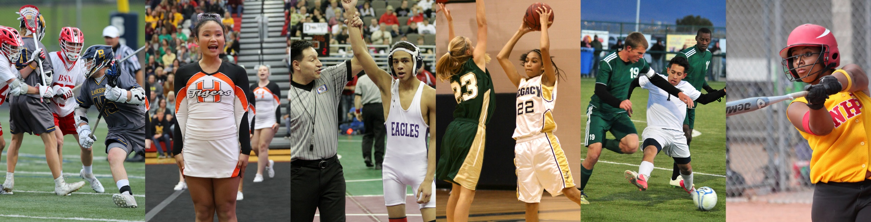
Thank You
National Federation of State High School Associations
PO Box 690 | Indianapolis, IN 46206
Phone: 317-972-6900 | Fax: 317.822.5700
www.nfhs.org | www.nfhslearn.com | www.nfhsnetwork.com

